Slide 1

Retail Promo vs. Non-Promo GMV Deep Dive Analysis

Slide 2
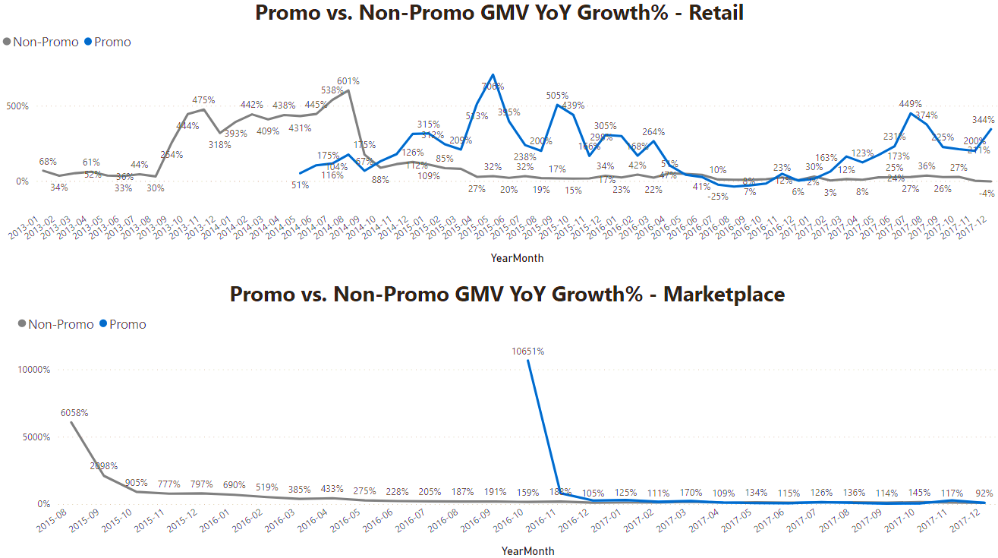
The YoY Non-promo GMV growth for Retail was gradually increasing until August 2014. A sharp drop can be observed between August 2014 and October 2014, thereafter the YoY non-promo growth continued in a downward trend. On the contrary, the Retail YoY Promo GMV growth started rising above non-promo growth in the same period Aug’2014-Oct’2014. Despite some fluctuations over the years in the Promo GMV growth, it continued to grow above non-promo GMV.
The YoY Promo and Non-Promo GMV growth for Marketplace has been following a similar trend.
Retail YoY Non-Promo GMV growth started declining while Promo increased

Slide 3
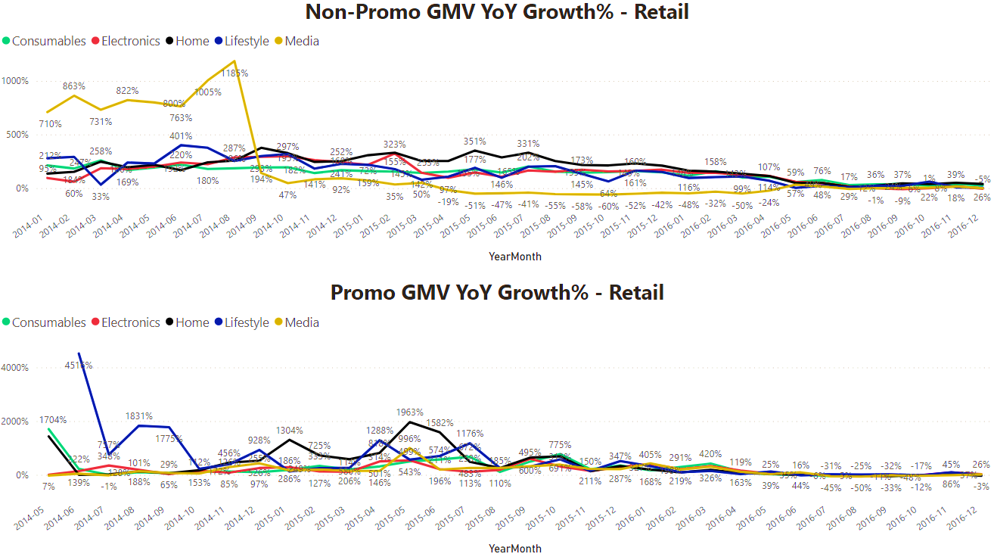
When the Retail YoY Non-promo GMV growth started declining between Aug’2014-Oct’2014 (as pointed out in the previous slide), it was mainly driven by the Media division. On the other hand, when the Retail YoY Promo GMV started rising above YoY non-promo GMV in the same period Aug’2014-Oct’2014, it was mainly driven by Home and Lifestyle division with the highest YoY Promo growth compared to other divisions.
Retail YoY Non-Promo GMV growth started declining while Promo increased

Slide 4
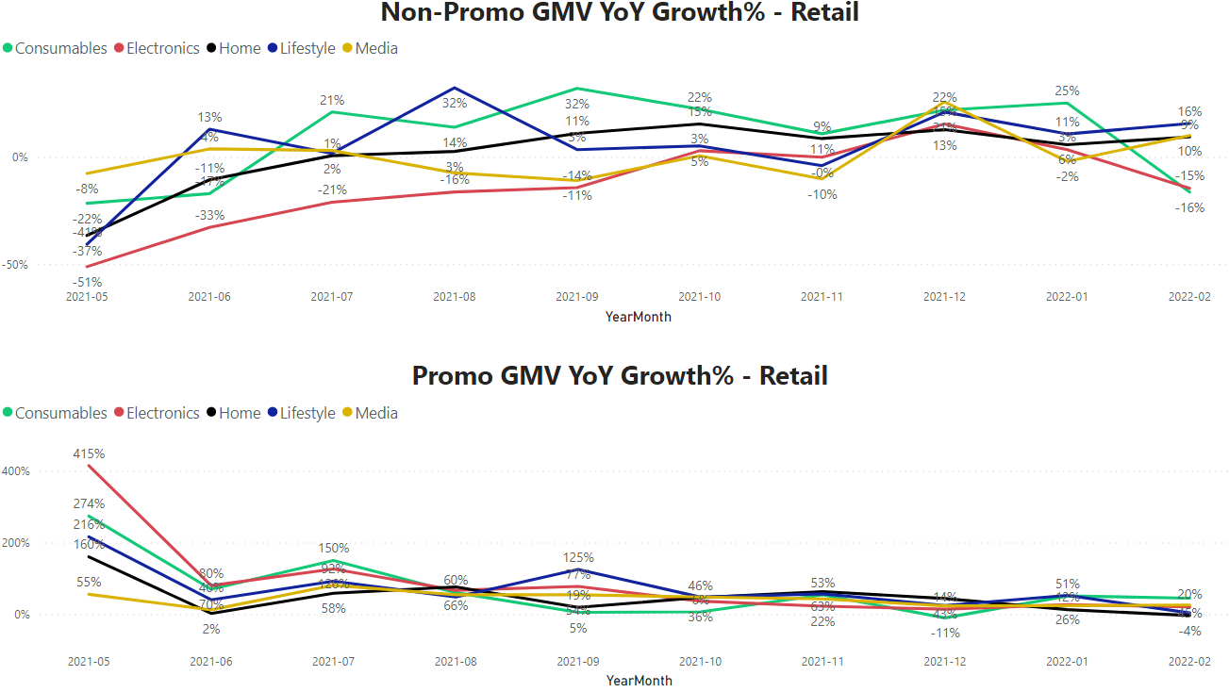
The most up to date (2021’Feb vs. 2022’Feb) YoY Non-promo GMV growth for Retail shows a negative growth of -4%. This is mainly driven by Electronics and Consumables division with a YoY non-promo GMV growth of -15% and -16%, respectively. The other Divisions have a positive YoY non-promo growth.
On the contrary, the most up to date YoY Promo GMV growth for Retail shows a positive YoY growth for all Divisions except Home with a
-4% YoY Promo GMV growth.

Slide 5
Reasons why Retail YoY Non-promo GMV growth has been declining while Promo GMV increased.

Slide 6
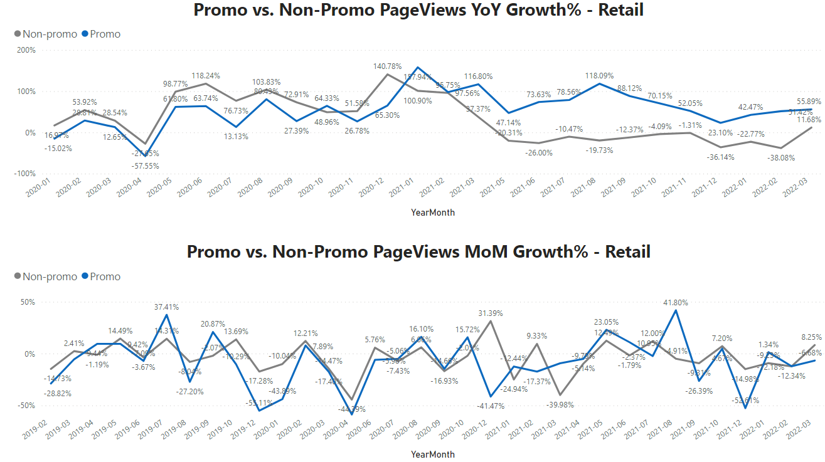
The YoY and MoM growth for Retail Promo pageviews has been increasing more than the non-promo pageviews for the last 2-3 years. This is one of the reasons the non-promo GMV has been declining while promo GMV has been increasing.

Slide 7
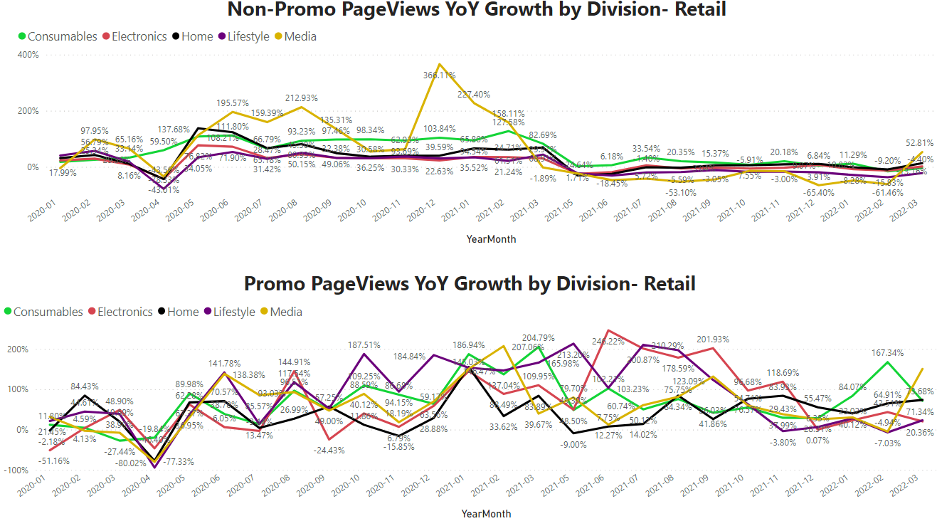
The Media, Consumables and Lifestyle divisions are the main drivers of the declining YoY non-promo pageviews growth for Retail.

Slide 8
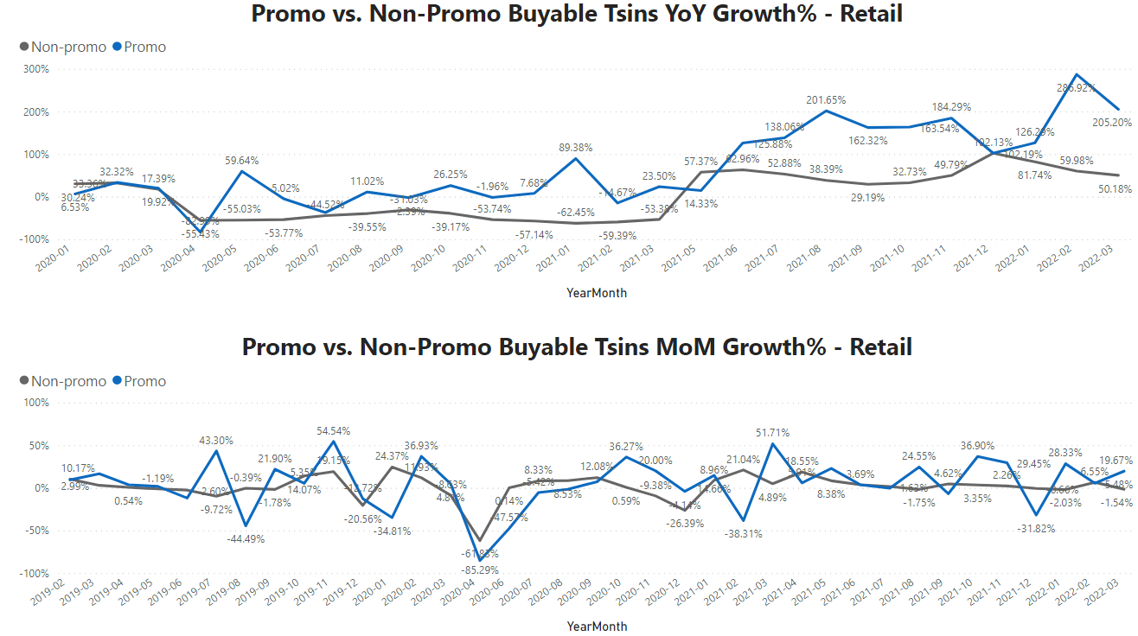
The number of buyable Tsins in promotions have been increasing YoY more than the buyable non-promo Tsins. This is another reason why the Retail YoY Promo GMV has been increasing more than the non-promo GMV.

Slide 9
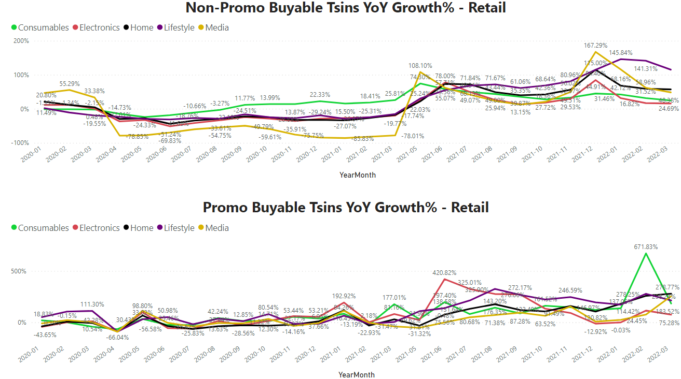
The decrease in the YoY Buyable non-promo Tsins is mainly driven by Media, Electronics and Consumables. This also explains the negative YoY non-promo GMV growth for Feb
(-4%) as these divisions had the highest negative growth.

Slide 10
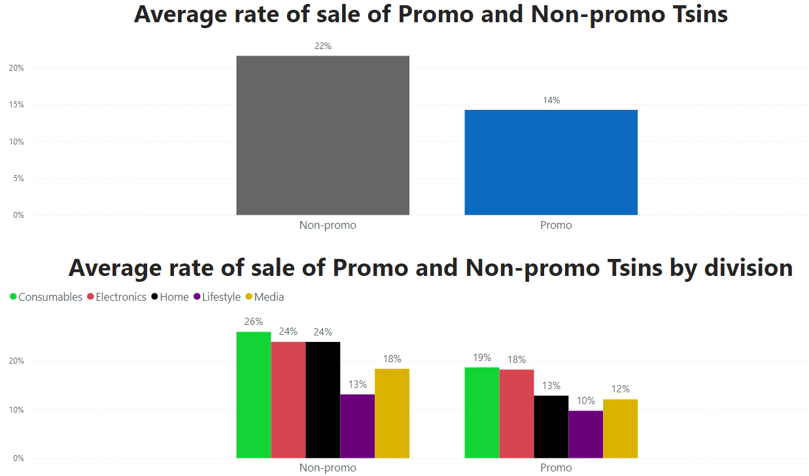
By comparing the average rate of sale of Promo and Non-promo Tsins for Feb’22, it’s clear that even though the average rate of sale of non-promo Tsins is a little higher than Promo Tsins, the difference is not that big considering that non-promo Tsins were 2 times more than promo Tsins. This is an indication that Tsins that are naturally selling were briefed into promo, hence this would increase promo GMV.

Slide 11
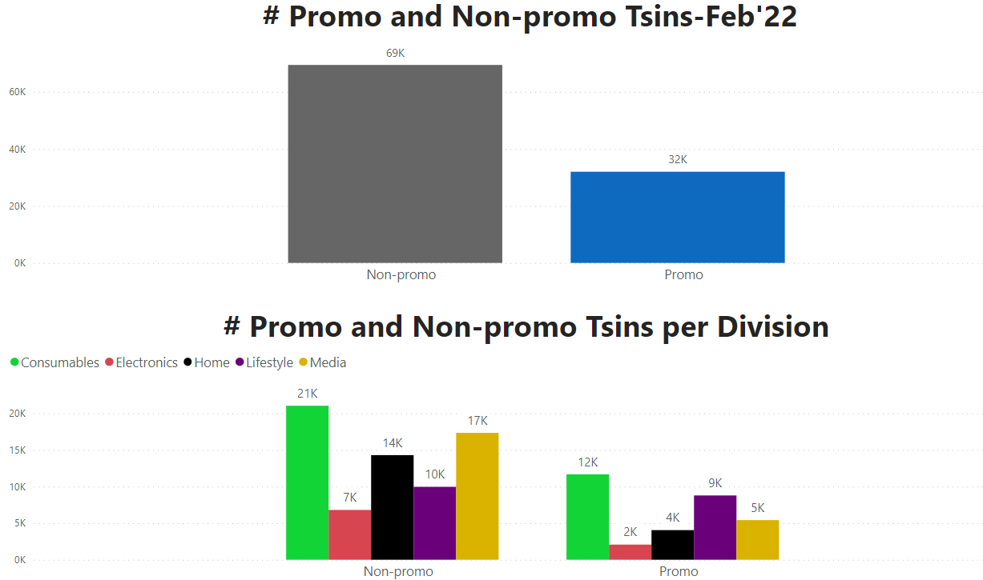
By comparing the average rate of sale of Promo and Non-promo Tsins for Feb’22, it’s clear that even though the average rate of sale of non-promo Tsins is a little higher than Promo Tsins, the difference is not that big considering that non-promo Tsins were 2 times more than promo Tsins. This is an indication that Tsins that are naturally selling were briefed into promo, hence this would increase promo GMV.

